Slide 1
How to Be Blessed Matthew 5:1-12
Dr. Rick Griffith, Crossroads International Church
BibleStudyDownloads.org

Slide 2
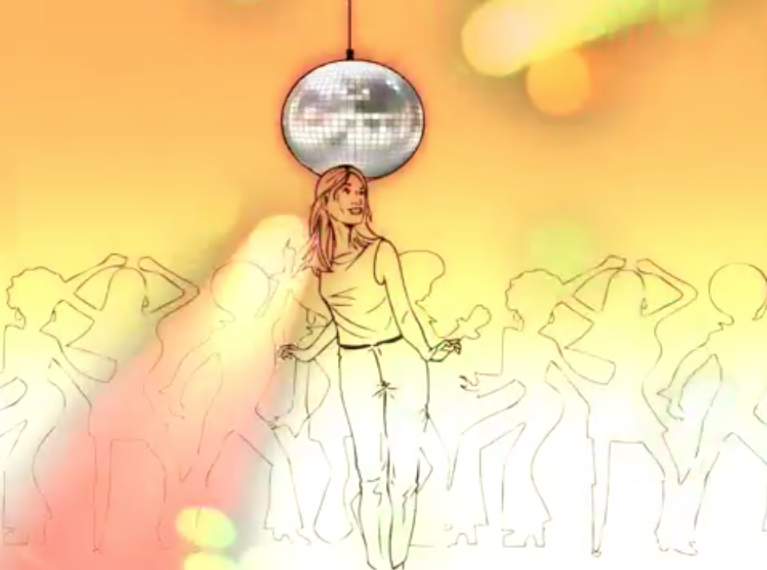
How to Be Happy in the Beatitudes
Notes:
Published on Apr 7, 2015
We all want to be happy. The question is, “How do we make that happen?” Explore a nonconventional path to true happiness.
Time elapsed is 2:26
https://www.youtube.com/watch?v=wxWCspyE7lg
Accessed 24 Jan 2016

Slide 3
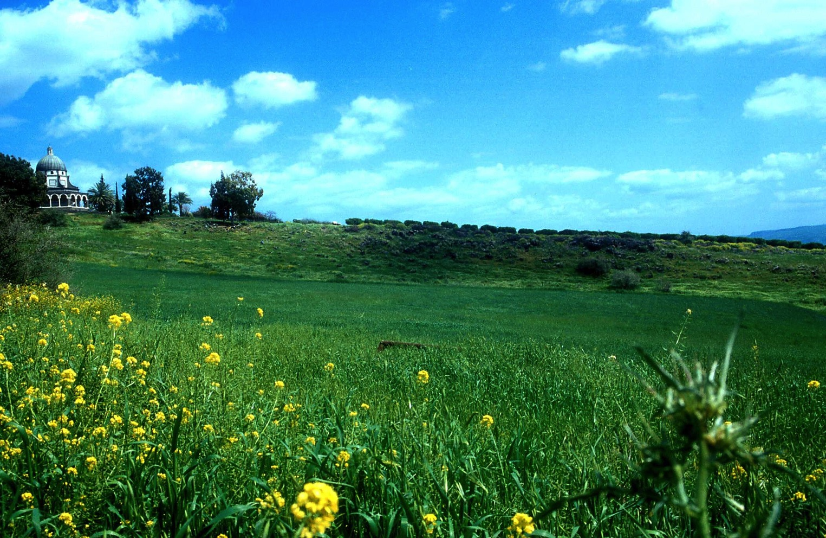
The Beatitudes in Matthew 5:1-12
Notes:
Matt. 5:1 Now when he saw the crowds, he went up on a mountainside and sat down. His disciples came to him, 2 and he began to teach them, saying:
Matt. 5:3 "Blessed are the poor in spirit,
for theirs is the kingdom of heaven.
Matt. 5:4 Blessed are those who mourn,
for they will be comforted.
Matt. 5:5 Blessed are the meek,
for they will inherit the earth.
Matt. 5:6 Blessed are those who hunger and thirst for righteousness,
for they will be filled.
Matt. 5:7 Blessed are the merciful,
for they will be shown mercy.
Matt. 5:8 Blessed are the pure in heart,
for they will see God.
Matt. 5:9 Blessed are the peacemakers,
for they will be called sons of God.
Matt. 5:10 Blessed are those who are persecuted because of righteousness,
for theirs is the kingdom of heaven.
Matt. 5:11 "Blessed are you when people insult you, persecute you and falsely say all kinds of evil against you because of me. 12 Rejoice and be glad, because great is your reward in heaven, for in the same way they persecuted the prophets who were before you.

Slide 4
How can you get blessed in life?
Website
Notes:
How can you get blessed in life? How can you experience a rich experience of life? I mean a richness that goes beyond money into a full satisfaction with life—how do we get that?

Slide 5
Is blessing in education?

Slide 6
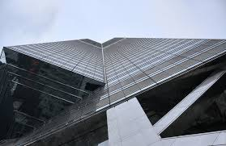
Is blessing in power or money?

Slide 7
Relationships with others?

Slide 8
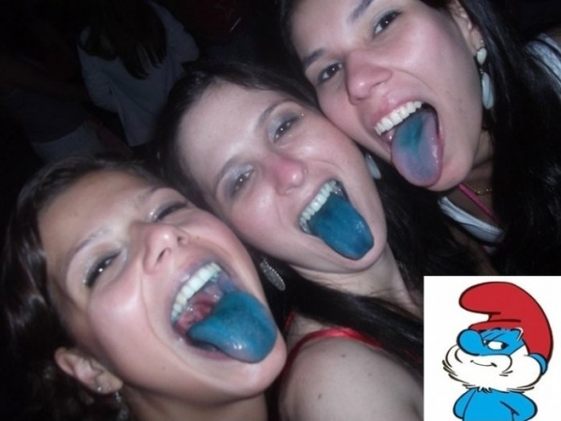
Fun?

Slide 9
Position? Looks?

Slide 10
Matthew: Jesus is King
But why believe this?
Notes:
Wanting a life of genuine blessing is something people have wanted for as long as individuals have been on earth. It certainly was desired in the time of Christ.

Slide 11
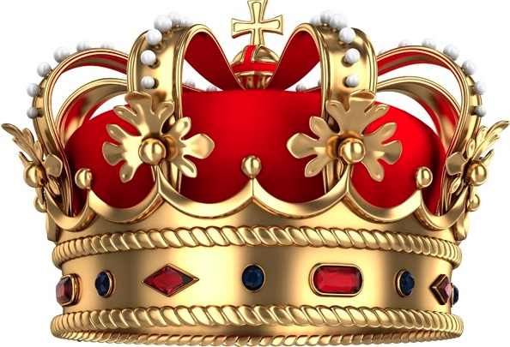
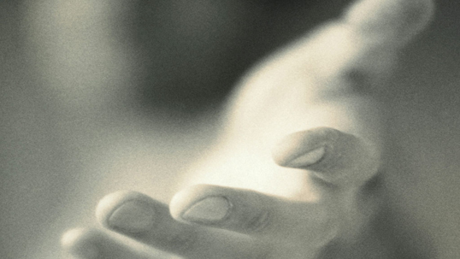
Jesus fulfilled all the requirements to be Israel's king.
Notes:
As we saw last week, Matthew answers the question of where satisfaction is found by saying it is found in Christ as King—Jesus fulfilled every requirement to be King.

Slide 12
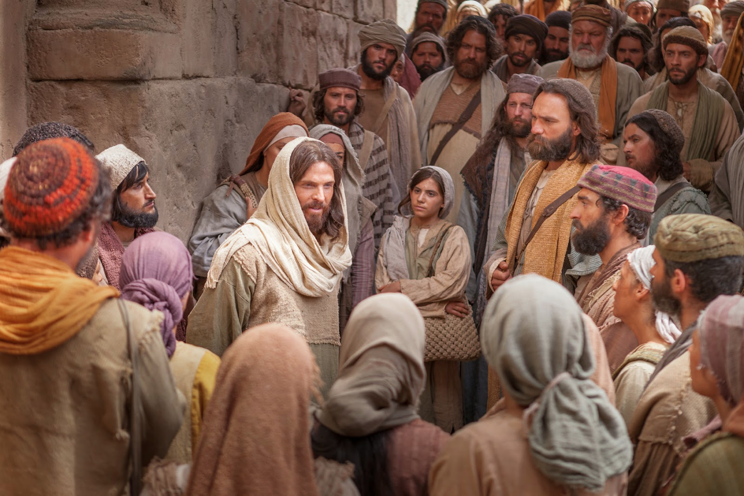
The Revelation of the King (Matt 1–10)
His Person (Matt 1–4)
Warren W. Wiersbe, Be Loyal: Following the King of Kings, 15
Notes:
Matt 1–10 reveals this King. Wiersbe notes that the revelation of the King falls nicely into three units.
• Matt 1–4 focuses on His person—He qualifies to be King of Israel and King of the entire world!

Slide 13
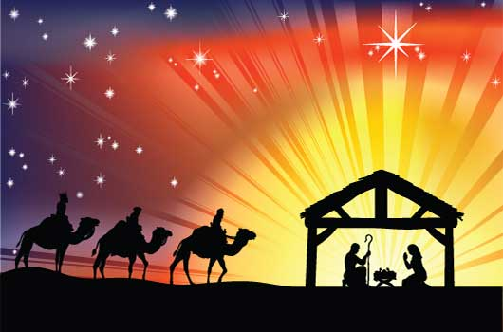
Proof Jesus is King (Matt 1:1–4:11)
Advent
Approvals
• Right lineage
• by John
• Virgin born
• by Father
• Magi worship
• by Spirit
• Humble origins
Notes:
Matthew 1–4 provide proofs that Jesus should be accepted as Israel's king. Jesus has the right physical line and is approved by key witnesses to be the King of Israel.
Both John (3:1) and Jesus (4:17) declare, "Repent, for the kingdom of heaven is at hand!" Repentance means a change of mind regarding who Jesus is. But what are the fruits of such a change of thinking?

Slide 14
The Revelation of the King (Matt 1–10)
His Person (Matt 1–4)
His Principles (Matt 5–7)
His Power (Matt 8–10)
Warren W. Wiersbe, Be Loyal: Following the King of Kings, 15
Notes:
Matt 5–7 gives His principles—the Sermon on the Mount shows the lifestyle that his subjects should show.
• Matt 8–10 reveals His power—the authority of King Jesus over nature, sickness, demons, and actually everything!

Slide 15
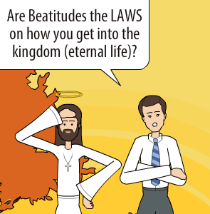
Are Beatitudes LAWS on how you get into the kingdom (eternal life)?
Notes:
The purpose of the Sermon on the Mount has been debated. What are these chapters about?

Slide 16
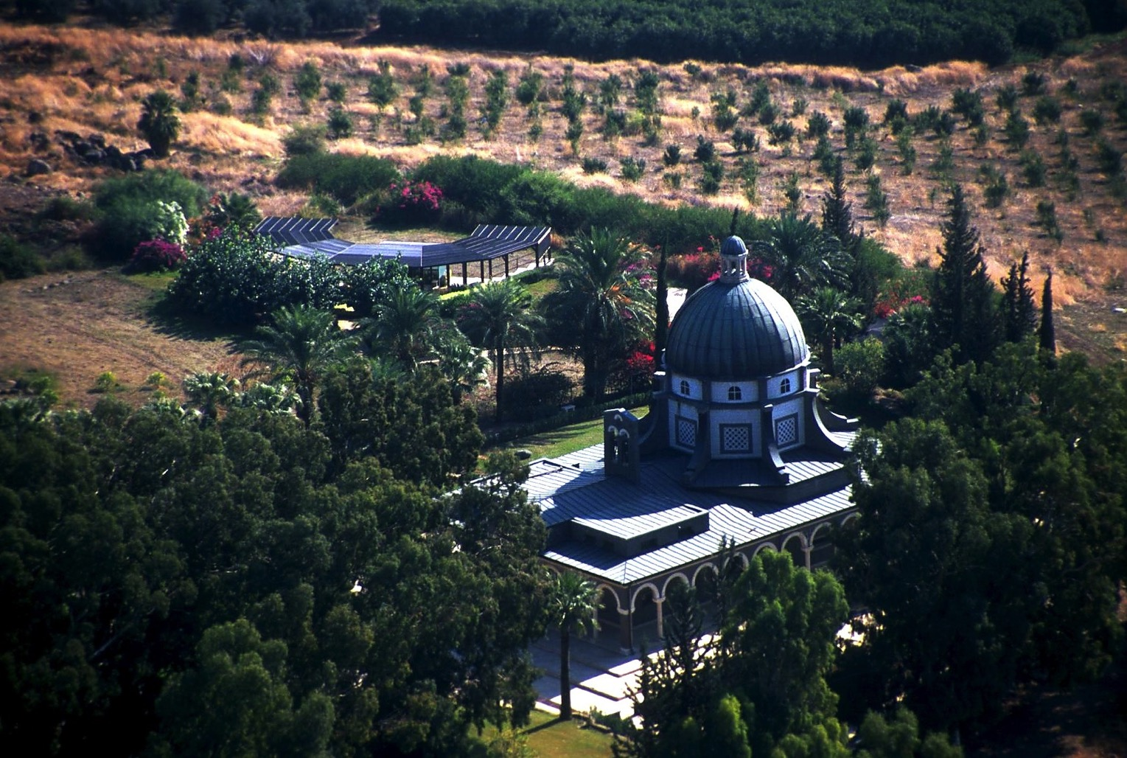
Purpose of the Sermon (Matthew 5–7)
A way to be saved?
A charter for world peace?
A model for the millennium?
An ethic for believers now?
Notes:
For these 20 Sundays we're digging into this most significant sermon ever. But what was Jesus actually saying in these three chapters?

Slide 17
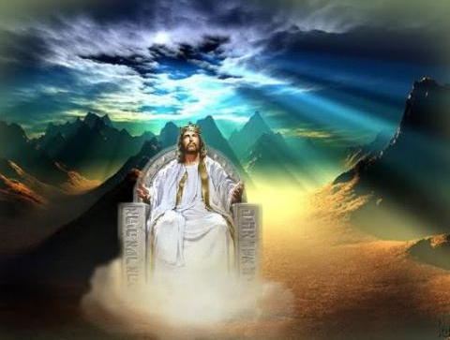
When Jesus is King… (Matthew 5–7)
What would your life look like if Christ was truly the boss of your life?
Notes:
The Sermon on the Mount (Matt 5–7) show what it looks like when someone has changed his thinking about Christ—the "fruits" of repentance.

Slide 18
Beatitudes
POOR IN SPIRIT
MOURN
MEEK
HUNGER & THIRST FOR RIGHTEOUSNESS
MERCIFUL
PURE OF HEART
PEACEMAKERS
PERSECUTED
Notes:
These who truly repent will possess an internal holiness more than mere outward show like the Pharisees.

Slide 19
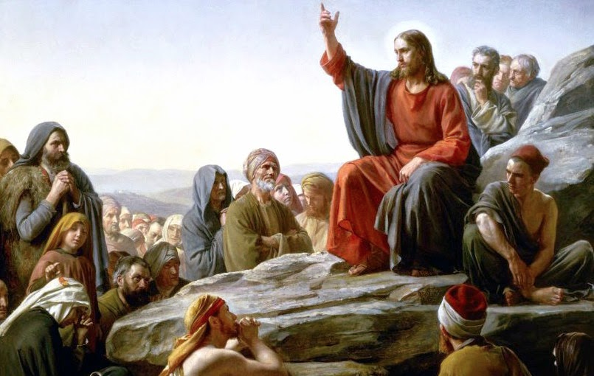
"Rabbi" Jesus
Notes:
The setting of the sermon shows Jesus taking the role of a rabbi to teach the disciples the response of those embracing him as king (Matt 5:1-2; Luke 6:17-19).

Slide 20
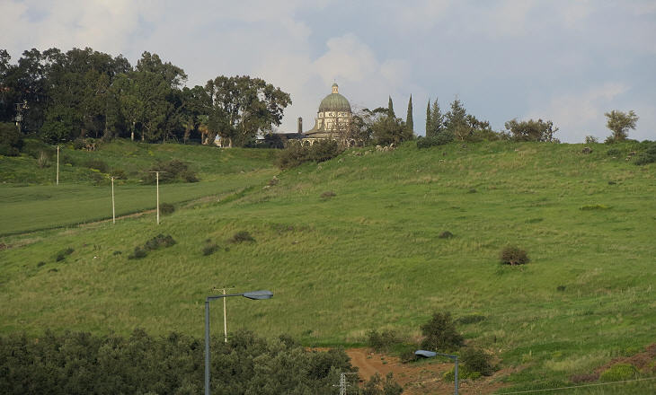
Mount of Beatitudes
Notes:
Jesus saw the crowds and sat down on a mountainside (1a).
The passage doesn't say specifically—though Luke calls this a "level place" (Luke 6:17). Putting the two together, Jesus found a level part of a mountain.

Slide 21
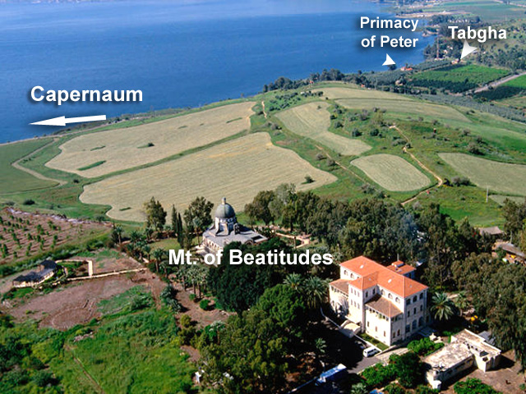
Mount of Beatitudes
Peter’s House
Synagogue
Sea of Galilee
Notes:
This describes the traditional location for this sermon, which is called "The Mount of Beatitudes" on the north shore of the Sea of Galilee.

Slide 22
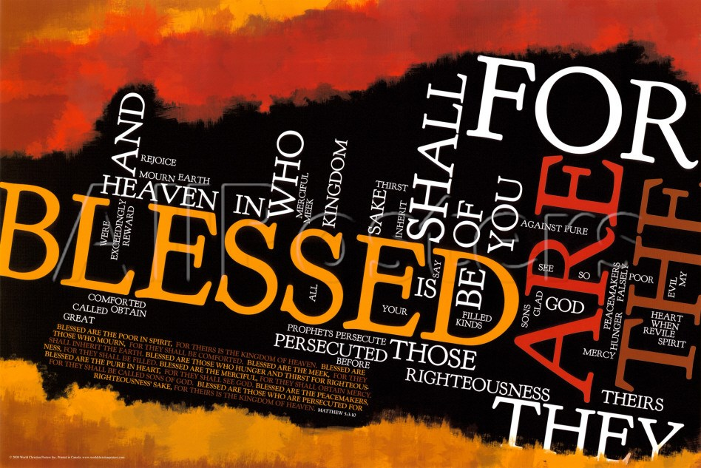
beatus (Latin for "Blessed")
Notes:
This is called "Beatitudes," after the Latin beatus, meaning "blessed."

Slide 23
Beatitudes
Notes:
Jesus began teaching his disciples who showed initiative to listen (1b-2).

Slide 24
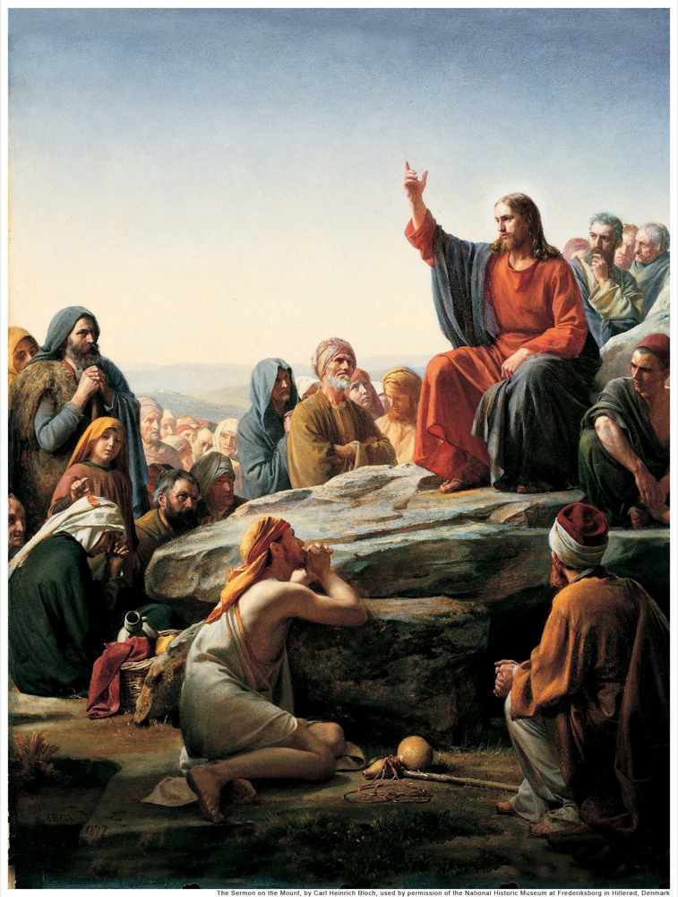
"Rabbi" Jesus
Notes:
Why did Jesus sit down (1)? Is this significant?
We typically have the teacher stand and the listeners sit. Of course, that only makes it tempting for the listeners to fall asleep. I have fallen asleep on may a sermon, but I've been fallen asleep while teaching or preaching.
Maybe these Jews are onto something once again. What a great idea! Contrary to our customs, at that time the teacher sat while the students stood! Maybe that's why they are called "stoodents"!
More seriously, Jesus was taking the role of the rabbi in that culture. He gladly accepted such a position and was often called "Rabbi" even though he had not gone through the rabbinic schools.

Slide 25
The Sermon on the Mount (Matthew 5–7)
Notes:
Was Jesus teaching only the disciples these beatitudes (2)?
Verse 2 specifically says that he was speaking to the disciples, not the curious crowds, which appear to be at the distance when he started speaking. That means his comments address those who already made a confession of faith for him.
However, by the time we get to the end of the sermon in 7:28 the crowds were amazed at his teaching. He also encouraged them to believe in him as their sure foundation (7:24-27), so the end of his message addresses the unbelieving multitudes who still needed to trust him for salvation.

Slide 26
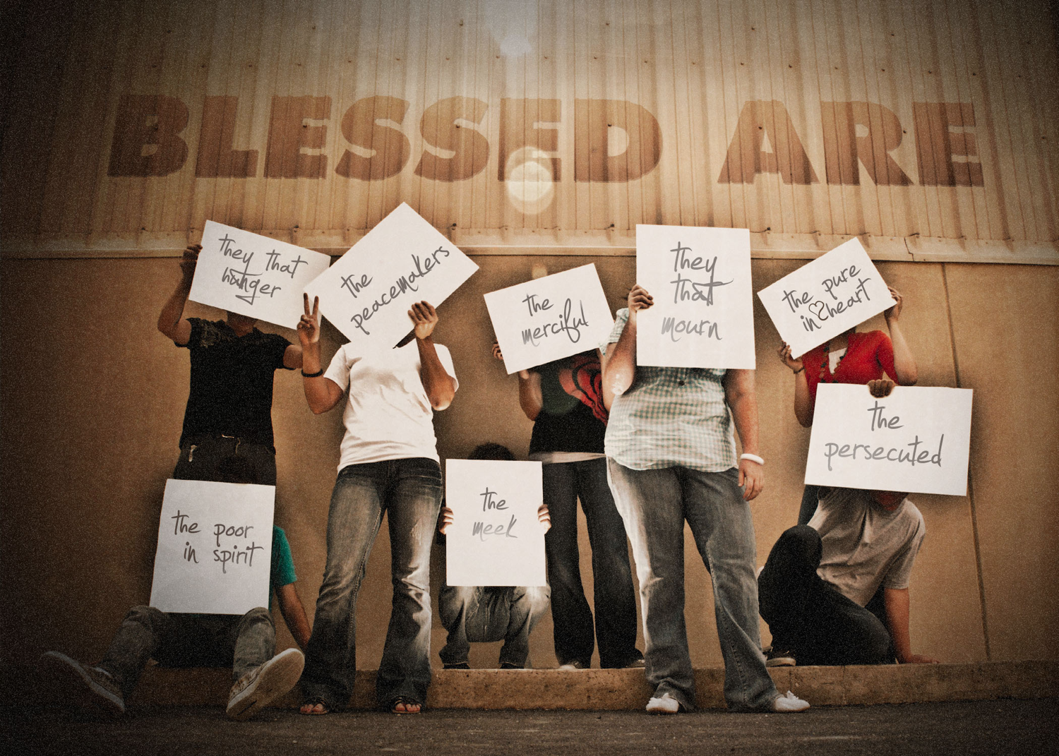
Beatitudes
Notes:
What is the basic contrast that Jesus is making between the first and second lines in these various statements (3-11)?

Slide 27
Beatitudes
POOR IN SPIRIT
MOURN
MEEK
HUNGER & THIRST FOR RIGHTEOUSNESS
MERCIFUL
PURE OF HEART
PEACEMAKERS
PERSECUTED
Notes:
Each first statement has these traits:
It shows a condition in which God blesses—when God adds a special measure of his grace so that we are better off than before.
That condition is an undesirable state—something people typically avoid.
Each first statement relates to character traits—something people typically also do not seek. Instead, we seek money, happiness, health, influence or power and so-called success.
"The qualities Jesus mentioned in this list, 'the poor in spirit,' 'those who mourn,' 'the meek,' etc., obviously could not be products of Pharisaic righteousness. The Pharisees were concerned primarily with external qualities, but the qualities Jesus mentioned are internal. These come only when one is properly related to God through faith, when one places his complete trust in God" (Louis A. Barbieri, Jr., "Matthew," in BKC, 2:29).

Slide 28
Beatitudes
Notes:
Each second statement also is parallel with one another in some ways:
Each second statement is the way God blesses us in a way parallel to the first statement—but it is upside down in nature—not what you'd expect!

Slide 29
…for they…
…for theirs is the kingdom of heaven
will be comforted
will inherit the earth
will be filled
will be shown mercy
will see God
will be called sons of God
…for theirs is the kingdom of heaven
Notes:
It is also something we typically do not seek—
However, this condition is what we really need!
In fact, it's also what we really want.

Slide 30
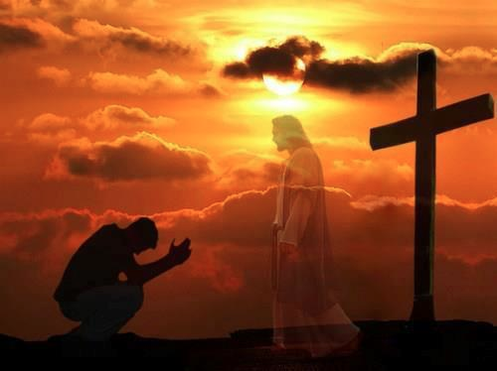
Results of believing in Christ (1-11)
What to do about these results (12)
Notes:
With that introduction, today we'll see the benefits or results of believing in Christ, followed by what to do about these results.
So how can you get blessed in life? It is found by faith or trust in God. In other words…

Slide 31
How can you get blessed in life?
Website
Notes:
How can you get blessed in life? How can you experience a rich experience of life? I mean a richness that goes beyond money into a full satisfaction with life—how do we get that?

Slide 32
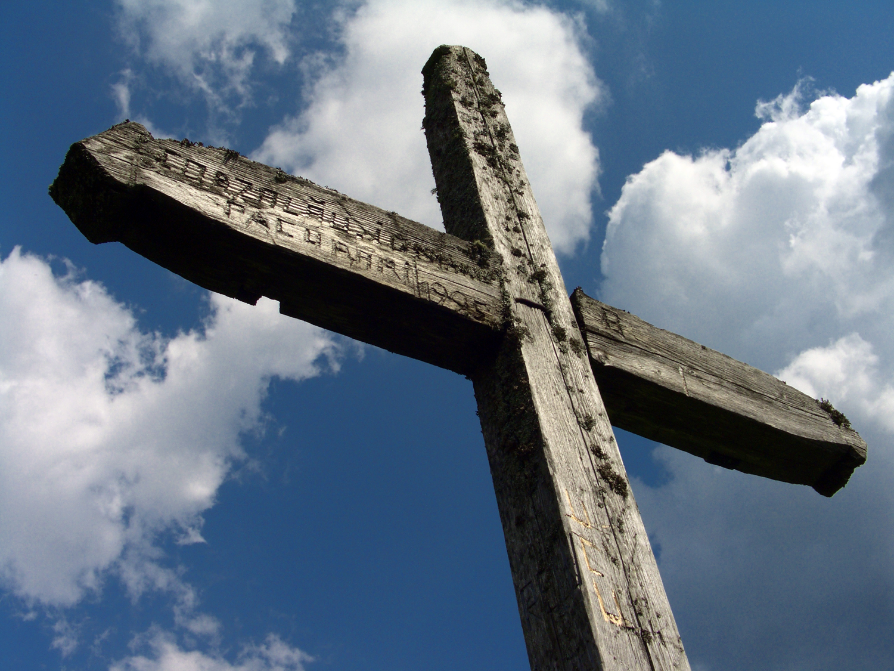
I. You get blessed by believing (Matt 5:1-11)!
Notes:
Those who trust Christ as King experience many rewards.

Slide 33
Matthew 5:1-16
"Being a master Teacher, our Lord did not begin this important sermon with a negative criticism of the scribes and Pharisees. He began with a positive emphasis on righteous character and the blessings that it brings to the life of the believer."
Warren W. Wiersbe, Be Loyal: Following the King of Kings, 46

Slide 34
Matthew 5:1-16
"The Pharisees taught that righteousness was an external thing, a matter of obeying rules and regulations. Righteousness could be measured by praying, giving, fasting, etc. In the Beatitudes and the pictures of the believer, Jesus described Christian character that flowed from within."
Warren W. Wiersbe, Be Loyal: Following the King of Kings, 46

Slide 35
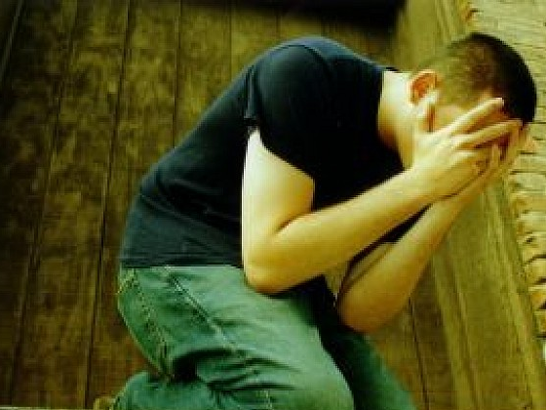
"Blessed are the poor in spirit" (5:3a)
Notes:
Depending on God leads to a rich experience of life (5:3).
What does it mean to be "poor in spirit" (3a)? It certainly does not simply mean that one is only "poor" as in the NLT! This implies that financial poverty is itself a blessing.
Instead, Jesus referred to those who are "poor in spirit," so he's referring to spiritual—not material—poverty.
But what's "spiritual poverty"? It means that we recognize that we have nothing to bring to God to earn his favor. We are truly poor without him, spiritually speaking. We are dependent upon him.

Slide 36
"…for theirs is the kingdom of heaven" (5:3b)
Notes:
What does it mean to inherit the "kingdom of heaven" (3b, 10b)?

Slide 37
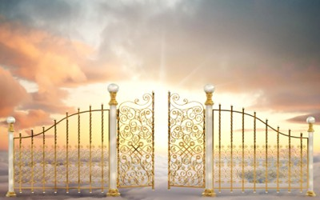
What does it mean to "enter the kingdom"?
Notes:
What does it mean to inherit the "kingdom of heaven" (3b, 10b)?
Whatever it means, remember that this exhortation is to the disciples, so it does not refer to salvation. It is written to believers, not unbelievers.

Slide 38
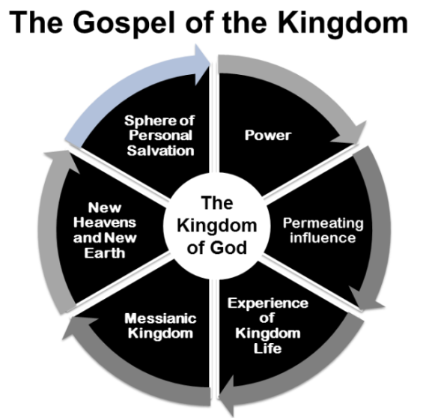
The Gospel of the Kingdom
Sphere of Personal Salvation
Power
The Kingdom of God
New Heavens & New Earth
Permeating Influence
Messianic Kingdom
Experience of Kingdom Life
Joseph Dillow, Final Destiny, 251
Notes:
First we must define what is meant by "kingdom." My friend Jody Dillow has done the most careful work on this of anyone I know in his 1093 page work. He writes, "A study of all places in the New Testament where the kingdom is mentioned reveals six aspects of the single kingdom of God: (a) the power of God, (b) a permeating influence throughout the world, (c) the messianic kingdom predicted in the Old Testament, (d) a kingdom way of living or the experience of kingdom life, (e) the new heavens and the new earth, and, finally, (f) the sphere of personal salvation."

Slide 39
What does it mean to "enter the kingdom"?
“…through many tribulations we must enter the kingdom of God” —Acts 14:22
Notes:
"Several important observations may be made about this list and diagram. First, kingdom entrance is sometimes spoken of as entrance into the sphere of personal salvation or into the future millennium. One must be born again if one is to enter the millennium (John 3:2-5). Paul tells us that 'Through many tribulations we must enter the kingdom of God' (Acts 14:22), that is, arrive at the final phase of our salvation, the millennium or the eternal state. Our journey toward the future kingdom requires perseverance through tribulations. When he tells us that we have been transferred into 'the kingdom of His dear Son,' he means we are currently in the sphere of personal salvation" (ibid., 251-52 emphasis his).
What is verse 3 saying about the Pharisees?
The Pharisees were the official interpreters of the OT—the "gatekeepers," if you will. Pharisees taught that the reason they were wealthy was because God blessed them due to their outward observance of the Law.
Jesus, on the other hand, came in conflict with them by teaching that they weren't even going to enter Christ's earthly kingdom. Why not? They were not even saved from sin and thus ready to enter the millennium.

Slide 40
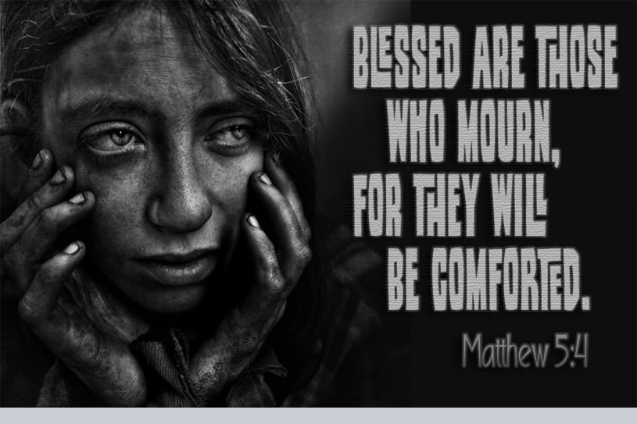
Blessed are those who mourn, for they will be comforted. Matthew 5:4
Notes:
Admitting our needs leads to receiving God's comfort (5:4).
What does it mean to "mourn" (4a)? Is this mourning for any reason? Why is it good for people to cry?
Some see this as turning from sin, and it might be.

Slide 41
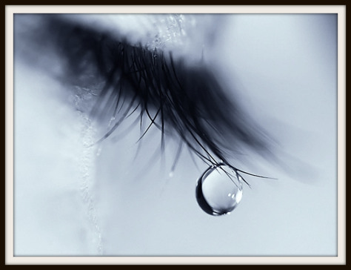
"Blessed are those who mourn"
Notes:
But the verse doesn't actually say what is being mourned. Perhaps it's repentance from sin, but it also might be like Romans 12 commands: "Rejoice with those who rejoice; mourn with those who mourn."
What a privilege it is to be able to feel with people, and to have others share in our sorrow. I have had many people weep in my study for a variety of reasons. They are blessed to be able to weep, and I am blessed to share it with them to try to provide some of God's comfort. Basically, to mourn is to recognize our needs.

Slide 42
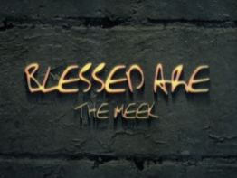
Blessed are the meek
Notes:
Humility now brings honor in the millennial kingdom (5:5).
What does it mean to be "meek" (5a)?
Unfortunately, in English "meek" rhymes with "weak," wen in reality it is strength of character shown in humility.
Meekness is a right estimation of oneself. If you really knew yourself, you wouldn't be proud!

Slide 43
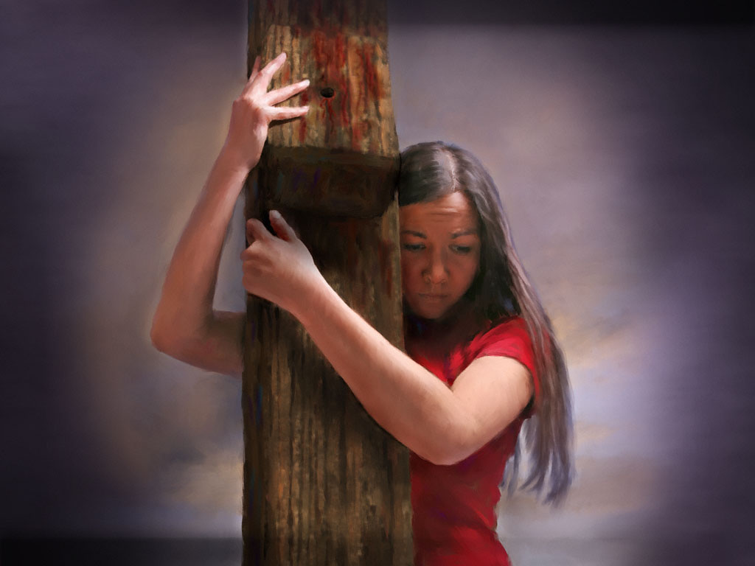
"Blessed are the meek"
"Meekness is not weakness, for both Moses and Jesus were meek men (Num. 12:3; Matt. 11:29). This word translated 'meek' was used by the Greeks to describe a horse that had been broken. It refers to power under control."
Warren W. Wiersbe, Be Loyal: Following the King of Kings, 46

Slide 44
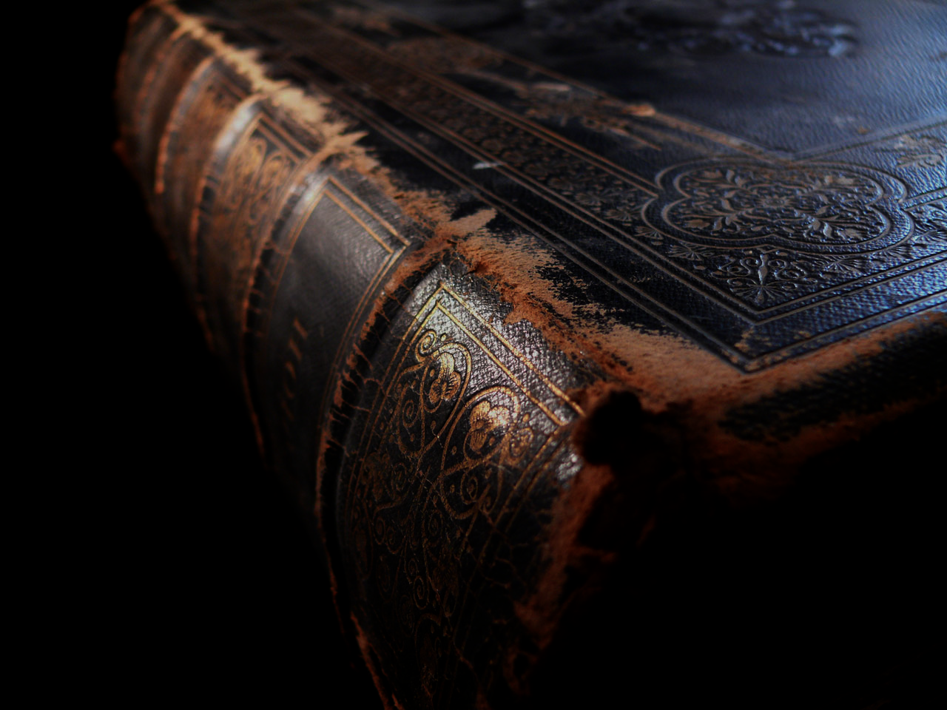
Meek means "gentle"
"Those who are meek (v. 5) are truly humble and gentle and have a proper appreciation of their position. (Praei√ß, the Gr. word rendered 'meek,' is translated 'gentle' in its three other usages in the NT: 11:29; 21:5; 1 Peter 3:4.)"
Louis Barbieri, "Matthew," in BKC, 2:29

Slide 45
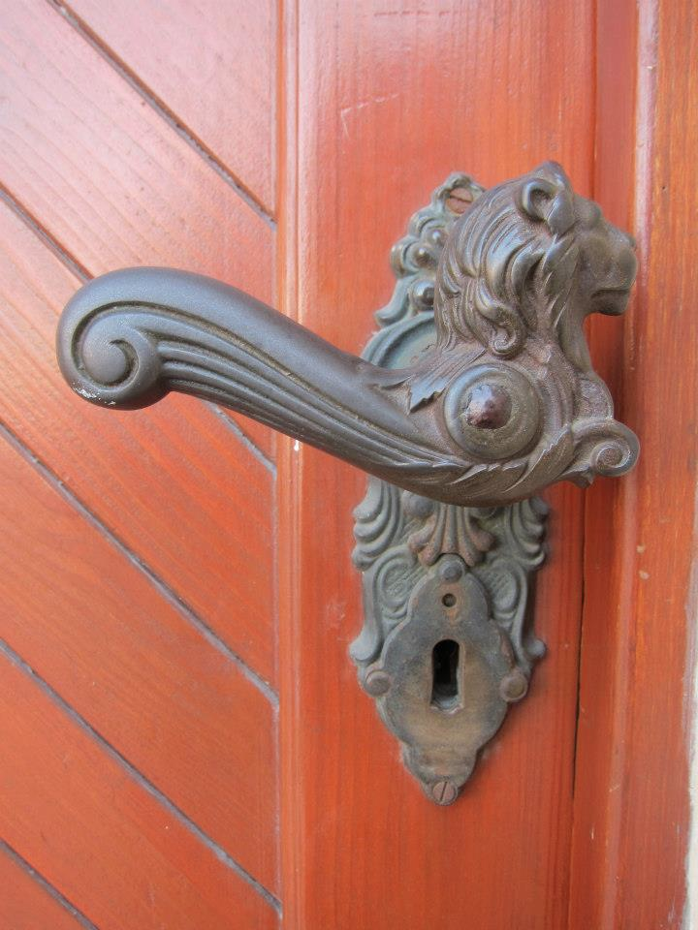
What does it mean to "inherit the earth" (5b)?
Notes:
Is this the same as to have the "kingdom of heaven" (3b)?

Slide 46
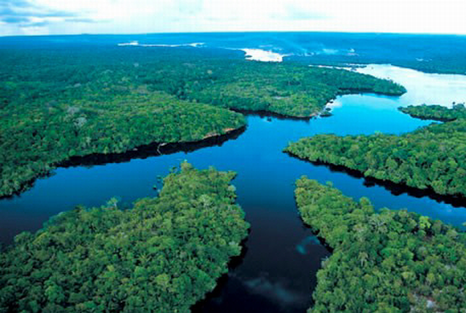
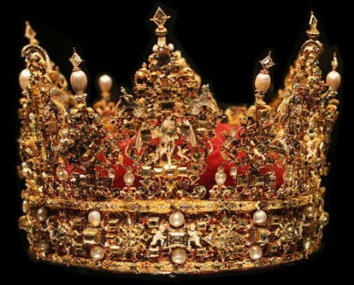
Believers will rule the earth (Rev. 5:10 NLT).
"And you have caused them to become a Kingdom of priests for our God. And they will reign on the earth."

Slide 47
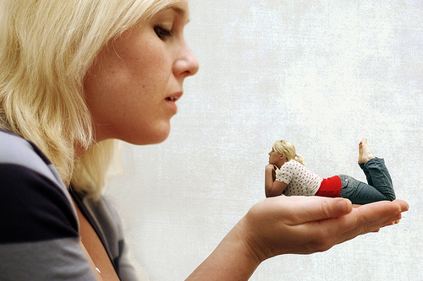
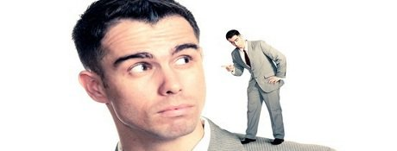
"Blessed are those who hunger and thirst for righteousness…"
”…for they will be filled."
Notes:
Holiness gives a deep satisfaction in life (5:6).
What does it mean to "hunger and thirst for righteousness" (6a)?
If you ask the average person on the street if he or she wanted to be holy, you would get a confused look. Who wants to be holy? Really? We want to be rich, healthy, influential, sexy, powerful—but holy? This isn't sought by the major religions or by people in general.
But the people of the Book are different. We should crave righteousness like we crave food—even more so.
What does it mean to be "filled" (6b)?
It means that holiness truly satisfies us.
We were created holy and we won't actually be fulfilled until we return to that original condition when God's creation was declared "very good" (Gen. 1).

Slide 48
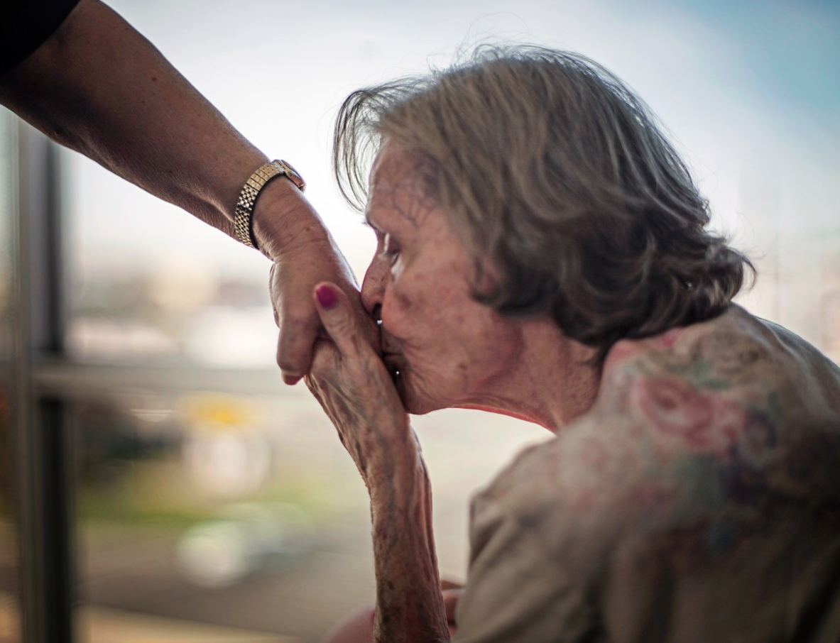
“Blessed are the merciful…”
“…for they will be shown mercy.”
Notes:
Showing mercy to others leads to receiving mercy from God (5:7).
What does it mean to be "merciful" (7a)?
Compassion towards the downtrodden is godly.
It is easy to disdain beggars rather than stop and listen to their story—and especially help them.
What does it mean to be "shown mercy" (7b)?
All of us want justice towards others and mercy for ourselves.
How many of us pray for justice towards us and mercy towards others?
The reality is that God works in us to experience the same mercy that we show others. That's kingdom living.

Slide 49
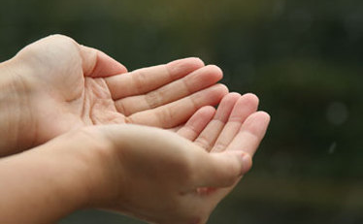
"Blessed are the pure in heart"
“…for they will be see God.”
Notes:
A pure lifestyle results in seeing God in our lives today (5:8).
What does it mean to be "pure in heart" (8a)?
Jesus is talking about motives here. More important that what you do is this: why do you do what you do?
One who is pure in heart is concerned with God's glory, not self-glory.
What does it mean to "see God" (8b)?
We know that since God is spirit, he cannot be seen. However, we can certainly see what he does.
It is unclear if this verse is talking about seeing God's work now or later, but, in any case, only the pure will see God's glory either in the present or the future. This, of course, means that not even all believers will see God's glory equally—those who genuinely know him are privileged to see more of Him.
Another view by Barbieri (BKC, 2:29) is that only Christians "will see God (v. 8), that is, Jesus Christ, who is God 'in a body' (1 Tim. 3:16; cf. John 1:18; 14:7-9)."

Slide 50
"Blessed are the peacemakers"
Notes:
Making peace with others enables us to be God's channel (5:9).

Slide 51
"Blessed are the peacemakers"
“…for they will be called sons of God.”
Notes:
What does it mean to be "peacemakers" (9a)?
Each of us is either contributing to conflict or peace in our world.
Which are you?

Slide 52
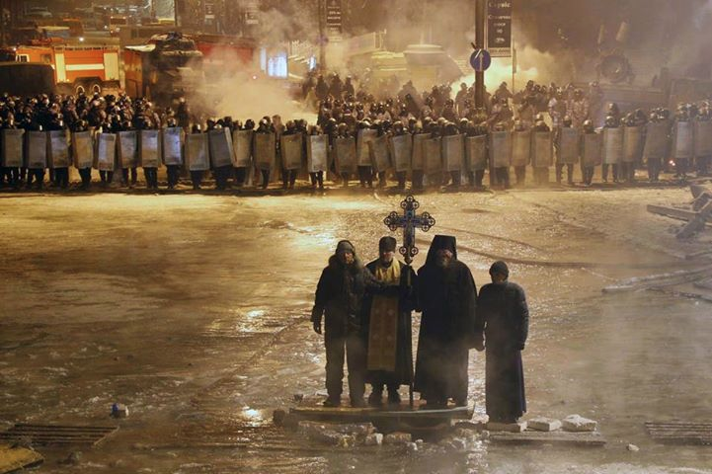
"Blessed are the peacemakers"
Notes:
What does it mean to be "called sons of God" (9b)?
Sons typically were channels of the values of their father.
This means that believers who live a life that brings peace will be channels to others of what God has in store in his kingdom.

Slide 53
Blessed are the persecuted
Notes:
Persecution for Christ gives us a rich experience of life (5:10-11).

Slide 54
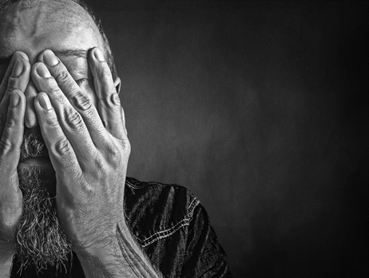
"Blessed are those who are persecuted because of righteousness, for theirs is the kingdom of heaven" (5:10 NIV).

Slide 55
"Blessed are you when people insult you, persecute you and falsely say all kinds of evil against you because of me" (5:11 NIV).

Slide 56
"Blessed are you when people insult you, persecute you and falsely say all kinds of evil against you because of me" (5:11 NIV).
This is suffering for righteousness by identiying with Christ
Notes:
The world hates us, have you noticed? Jesus was not just talking about ISIS, who kill Christians. Jesus referred to all who are convicted as they look at your holy life, your being a blessing to others, etc.
It's no secret that Christians are marginalized in just about ever facet of society.

Slide 57
I. You get blessed by believing (5:1-11)!
Notes:
Those who trust Christ as King experience many rewards.

Slide 58
Beatitudes
Notes:
Up to this point Jesus has indirectly encouraged his listeners to respond to Christ as King. For this reason, these have also been called "be attitudes" with a double t. But certainly we can do something, too, right? Up to this point, Jesus hasn't directly told them what to do. Now, in our final verse today, he gives us a command to…

Slide 59
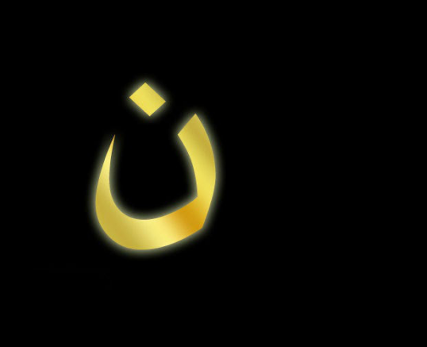
II. Be glad to suffer for Christ (5:12)!
Notes:
Rejoice over being persecuted.

Slide 60
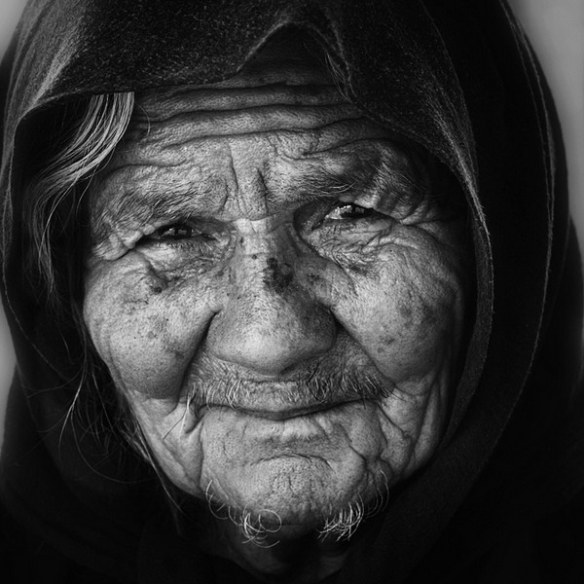
"Rejoice and be glad, because great is your reward in heaven, for in the same way they persecuted the prophets who were before you" (5:12 NIV).

Slide 61
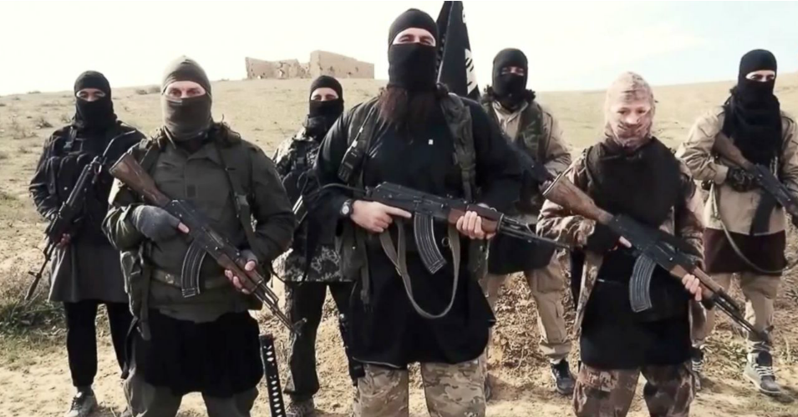
ISIS
Notes:
How can we "rejoice and be glad" when persecuted (12)?
ISIS has become the face of evil.

Slide 62
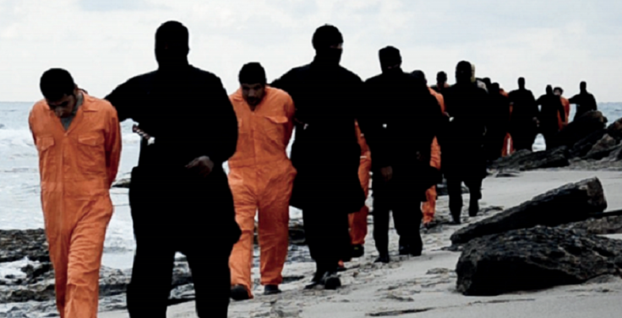
ISIS
Notes:
Take the example of the Egyptian believers brought to the beach for execution simply for being Christians.

Slide 63
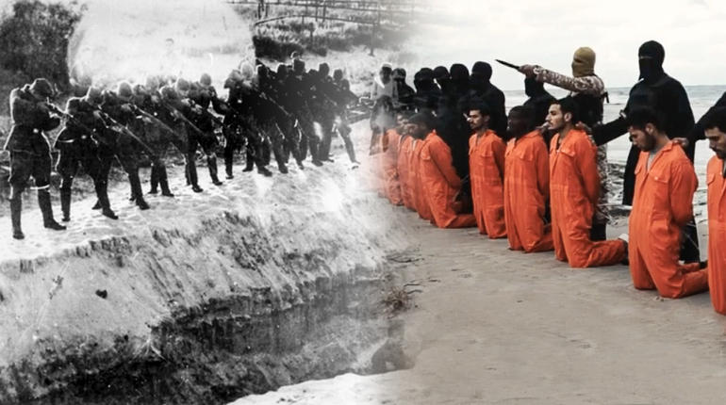
ISIS
Notes:
The video footage of their murder shows them singing praises to God all the way until their throats were cut and heads lopped off.
Is it not proper for you and I also to be glad for the lesser ways we bear his name?
God promises that we will have a great reward in heaven (12a)!

Slide 64
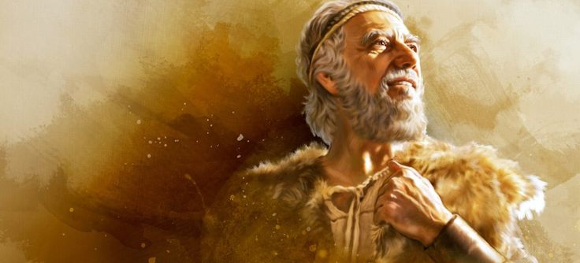
The OT Prophets
"…for in the same way they persecuted the prophets who were before you" (5:12 NIV).
Notes:
Identify with persecuted OT prophets (5:12b).
Which OT prophets were persecuted (12b)?
Actually, which were not persecuted?
Jeremiah suffered through the famine and destruction of Jerusalem, was thrown into a cistern where he sank into the mud, and was jeered by thousands.
Ezekiel saw the death of his wife as an example of the siege of Jerusalem.
Isaiah was sawn in half by the wicked King Manasseh.

Slide 65
How can you get blessed in life?
Website
Notes:
How can we sum up the way to be blessed in 5:1-12?

Slide 66
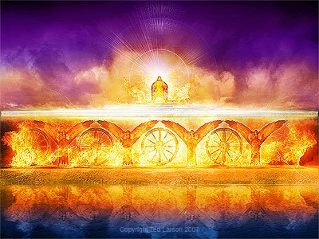
Believer attitudes bring blessing (Main Idea).
Notes:
God rewards us not for our actions but first in our attitudes that produce good deeds.

Slide 67
When Jesus is King… (Matthew 5–7)
What would your life look like if Christ was truly the boss of your life?
Notes:
The Sermon on the Mount (Matt 5–7) show what it looks like when someone has changed his thinking about Christ—the "fruits" of repentance.

Slide 68
I. You get blessed by believing (5:1-11)!
Notes:
Those who trust Christ as King experience many rewards.

Slide 69
II. Be glad to suffer for Christ (5:12)!
Notes:
Rejoice over being persecuted.

Slide 70
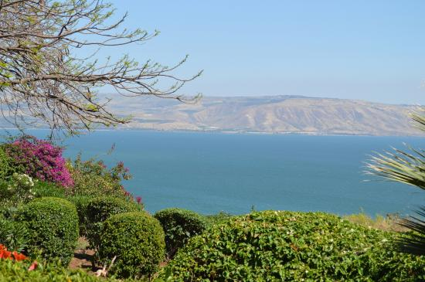
Questions to Consider
Which one of the Beatitude character qualities do you lack most?
•
How can you grow in that area? •
How can you better identify with persecuted believers?

Slide 71
NT Sermons link at biblestudydownloads.org
Get this presentation and script for free!

Slide 72
Black

